Slide 1
Neighborhoods of Oahu
Trends and Insights for Incoming Residents
Brock Schmalzel, August 2020

Slide 2
Where to live on Oahu?
Thousands of people move to the island of Oahu each year from the U.S. mainland and from abroad
When deciding where to live, there are other factors beyond cost of rent and household amenities. Some incoming residents may intend to open a business while others come with their families and care about nearby schools and crime rates.
Is it possible to provide insights about the different neighborhoods of Oahu to incoming residents?

Slide 3
Data
Oahu Zip Codes: 56 zip codes on the island of Oahu
Foursquare City Guide: This mobile app provides information on places and venues in a given area
Honolulu Police Department’s 2018 Annual Report: This report provides crime data for each of Oahu’s 8 crime districts
2018 Strive HI Performance Results: Hawaii State Department of Education data on public schools

Slide 4
Processed Data
Foursquare was used to query venues in a 1000 meter radius around the latitude/longitude coordinates for each zip code. Top 10 most common venues in each zip code were calculated
Normalized public high school test data (sum proficiency = total math, language, and science scores)
Normalized crime data uses total crimes for each crime district
Zip Code | Sum Proficiency | School(s) | Total Crimes | 1st Most Common Venue | 2nd Most Common Venue | 3rd Most Common Venue | 4th Most Common Venue | 5th Most Common Venue
96701 | 0.068594 | Aiea High | 0.2453 | Mobile Phone Shop | Burger Joint | Golf Driving Range | Bank | Jewelry Store
96706 | 0.351234 | Campbell High | 0.4075 | Home Service | Park | Clothing Store | Golf Course | Restaurant
96707 | -1.124775 | Kapolei High | 0.4075 | Video Store | Coffee Shop | Supermarket | Business Service | Doctor's Office
96731 | -0.528091 | Kahuku H&I | -0.9182 | Airport | Trail | Yoga Studio | Dive Bar | Flower Shop
96734 | 0.304127 | Kailua High, Kalaheo High | -0.9182 | Beach | Construction & Landscaping | Food Truck | Tennis Court | Yoga Studio

Slide 5
Methodology
K-Means Clustering
K-means clustering was applied to the venue data to identify trends among the various zip codes.
Once clustered, the most common venues and—more importantly—the venues not found in other clusters would be identified.
Three versions of this algorithm was completed using:
Venue data for all Oahu Zip Codes
Venue, school, and crime data for Oahu Zip Codes with at least one public high school
Crime per population and wealth index data for Oahu Zip codes with at least one public high school
Regression
Pearson’s Correlation Coefficient calculated to analyze correlation between crime and school performance.
Ordinary least squares method was used to perform multiple linear regression to see how well crimes-per-population and wealth index could predict school performance

Slide 6
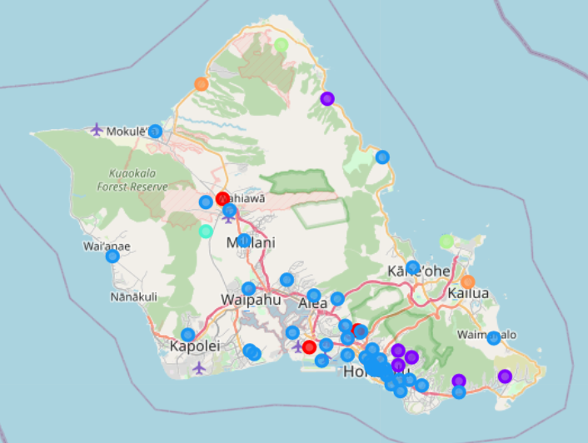
Results Venue Only
Cluster | Number of Zip Codes | Unique Venues
Red | 3 | Pizza Place, Golf Course, Bowling Alley
Purple | 6 | Trail, Scenic Lookout, “Food”
Cyan | 1 | Post Office, Doctor’s Office
Orange | 2 | Beach
Green | 2 | Airport, Yoga Studio, Donut Shop
Blue | 42 | Asian Cuisine, Coffee shops, Parks

Slide 7
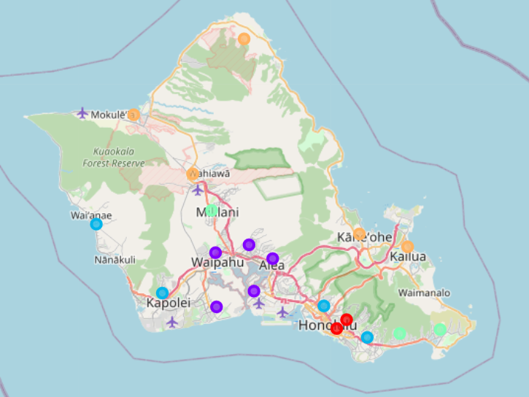
Results Venue, School, and Crime
Cluster | Number of Zip Codes | Common Venues | School Scores | Crime
Red | 2 | Cafe | - | Very Higher
Purple | 5 | Gold Course, Park | Higher | Higher
Cyan | 3 | Park, “Food’, Trail | Higher | Lower
Orange | 5 | Farmer’s Market, Café, Yoga Studio, Electronics | Lower | Lower
Blue | 4 | Coffee Shop, Pizza Shop, Diner | Very Lower | Higher

Slide 8
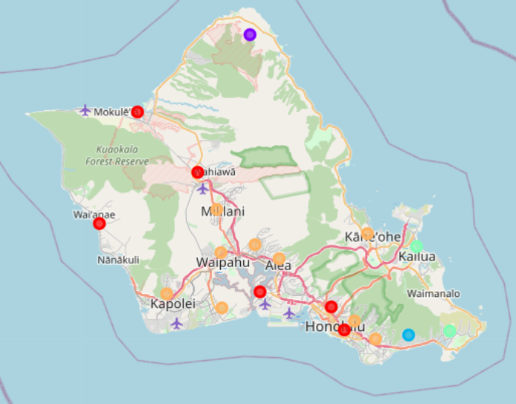
Results Crimes and Wealth Index
Cluster | Number of Zip Codes | Wealth Index | Crimes Per Population
Red | 6 | Lower | Mixed
Blue | 1 | Very Higher | Higher
Purple | 1 | Lower | Much Higher
Green | 2 | Higher | Lower
Orange | 9 | Mixed | Lower

Slide 9
Results Regression
No significant correlation between total number of crimes in a zip code’s district and its high school(s)’ average test scores (r(17) = -0.0187, p=0.939)
Multiple linear regression model (using ordinary least squares) with the average test scores as a function of a zip code’s wealth index and crimes per population yielded a model score of only 0.244
Significant positive correlation between a zip code’s wealth index and its high school(s)’ average test scores (r(17) = 0.494, p=0.032)

Slide 10
Observations
Dominant Venue Cluster. Large, dominant cluster consistent with greater Honolulu downtown area.
Unequal Zip Codes. Varying population density across Oahu caused Foursquare query issues:
Rural zip codes return little-to-no venues
Urban zip codes overlap with each other
Business Examples. Useful insights for identifying which neighborhoods favor different styles of cuisine
Schools, Crime, and Wealth. Hypothesized that these societal metrics are related to each other. If someone is interested in one, they should consider the others to get the full picture.
Generic Venues. Foursquare returned generic venues such as “Food” and “Restaurants”. This likely worsened the performance of the clustering algorithm

Slide 11
Recommendations
Adjust the Foursquare query radius according to the population density of target area
Drop or classify Foursquare data that is generic e.g. “restaurant”
Consolidate Foursquare data into larger categories. There may be value gained by creating categories such as Asian cuisine (Japanese, Chinese, Korean, etc), outdoor activities (trail, beach, park, etc), or white-collar (event planning, doctor’s office, etc
Develop a consistent technique for identifying venue trends within a cluster
Two recommendations related to improving the data behind the school-crime-wealth analysis
More comprehensive assessment of schools beyond test scores such as attendance, graduation, and college acceptance rates
Break down the amount of crime by zip code rather than lumping them into a single crime district

Slide 12
Conclusion
When a rental unit costs the same in Pearl City as another unit in Hawaii-Kai, what other factors can be considered?
The K-means cluster algorithms used in this study found that distinct trends could be found between neighborhoods on Oahu
Pearl City’s Cluster: Diverse restaurant options and parks. Lower than average crime.
Hawaii-Kai’s Cluster: Trails and scenic lookouts. Lower than average crime and higher than average wealth index.
Differences between clusters were not always clear
Much work remains to improve the clarity and utility of the approach laid out in this report, but initial results are promising

